Slide 1
How to get a script from existing audio file

Slide 2
Process Info
Owner name | Damien Lerminaux
Team | DnD
Resources | Audio or video file
Tools | Word Online
Description | How to get a script if needed and only audio is available in the Storyboard
 | Annarose | AU Member | AU Member | AU Member | AU Member | AU Member | AU Member | AU Member | AU Member
Date | April 7, 23

Slide 3
Summary
The idea of this how to is to explain how to get help from the dictate option of Word online to get the transcript of an existing audio. It could be useful for :
Preparing a re-recording
Adding subtitles
Preparing a translation

Slide 4
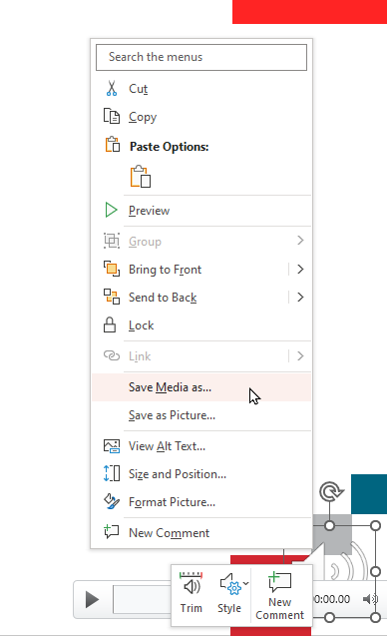
Step 1
Save the audio on the slide as a file
  (Right click on the audio Icon / save the media as…)

Slide 5
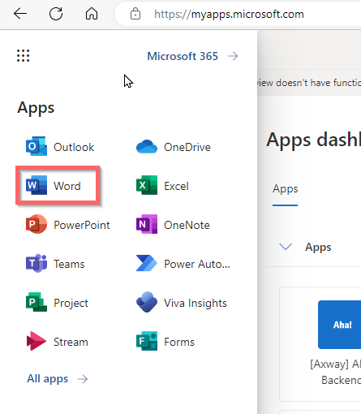
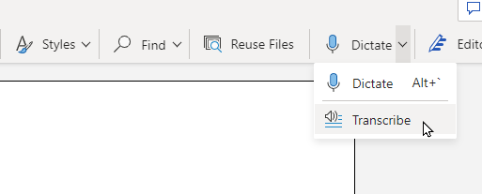
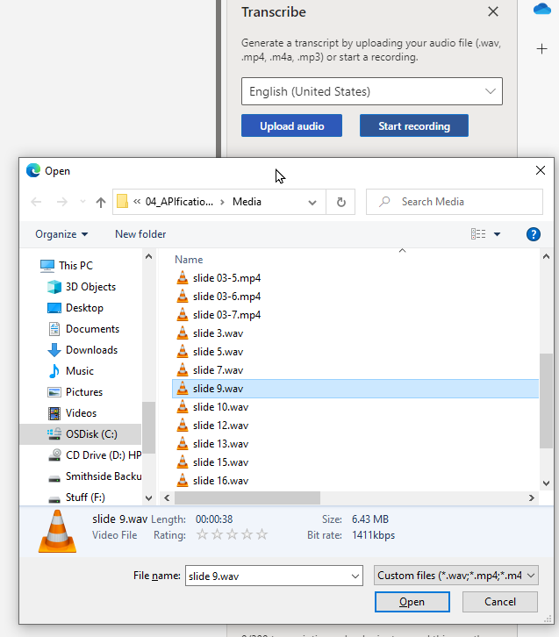
Step 2
Open word online version and create a new document
Click on Dictate / transcript on the top right of the banner
Click on Upload audio, then select it on the folder window

Slide 6
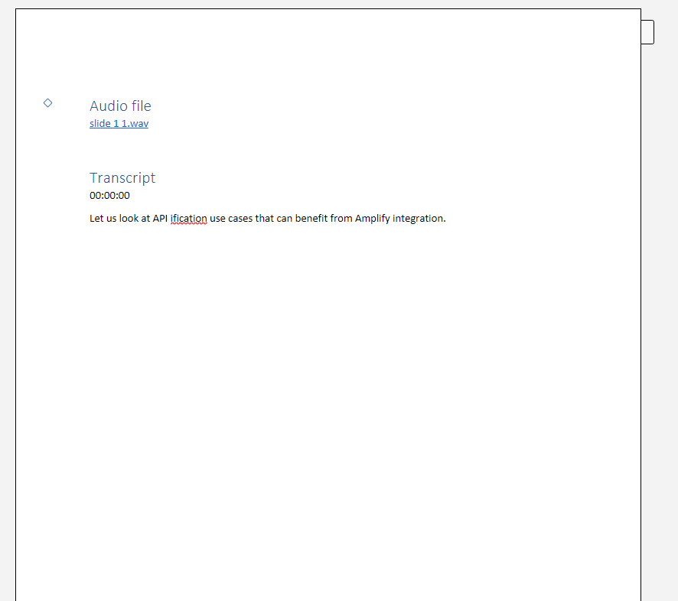
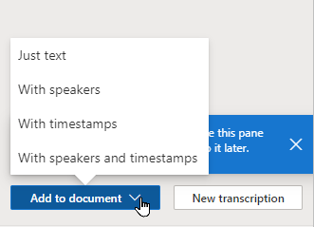
Click on Add to document and select the option needed
You now have a transcript of the audio ready to be checked and used for a script.

